Slide 1
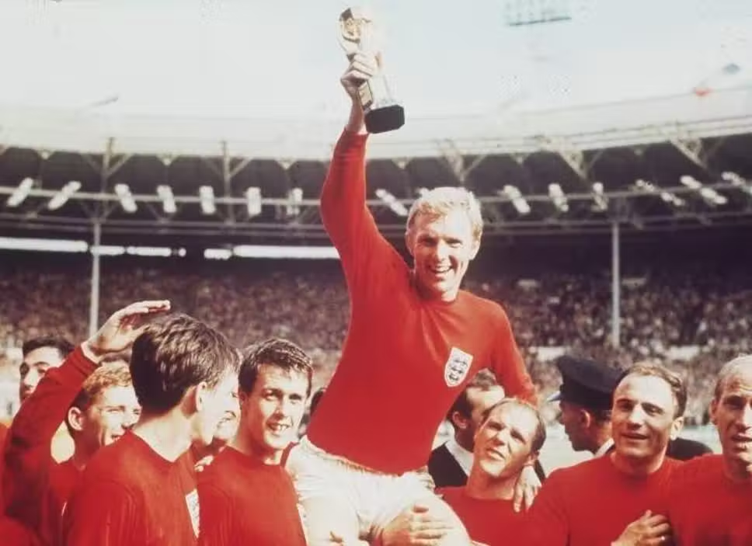

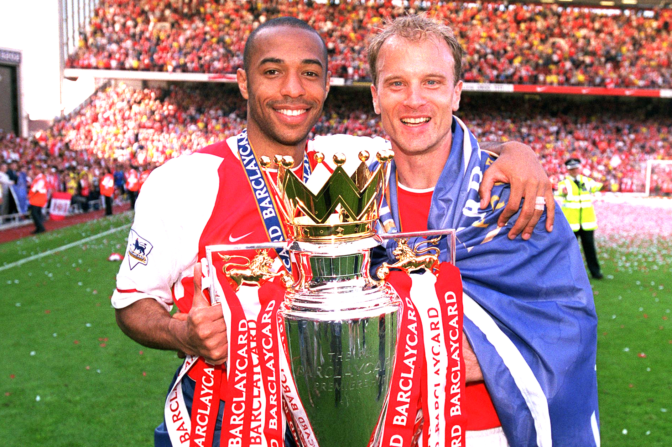

Football Tournament Database (Rockborne Edition)
Nino and Pavanith

Slide 2
Overview
TASK 1:
ER Diagram
TASK 2: Implementation
TASK 3:
Testing
TASK 4: Conclusion

Slide 3
Case Study Brief
Case study was based on six a side football tournament for Rockborne.
With 4 club teams playing both home and away games.
3 venues and players from different cohorts .

Slide 4

Task 1 : ER Diagram Key
Entity relationship diagram - a type of flowchart which defines entities and how they related to each other within a multiple table system.

Slide 5
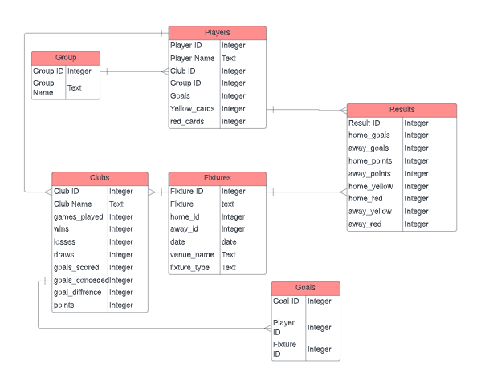

Slide 6
Data Dictionary
Data attribute | Meaning | Format
Group name | The name of the group | Text
Date/Time | Time and date of the football match | Date
Venue | Name of the venue | Text
Player name | Name of the player | Text
Fixture type | Is the fixture a friendly or a tournament match | Text
ID Goal ID, Match ID | Unique character | Number
Goals difference | The difference between goals scored and goals conceded | Number

Slide 7
Task 2 : Implementation
Data was initially extracted from a pdf document and separated into tables in one Excel workbook.
Data that had been copied and pasted required trimming.
A new database was created in pgAdmin to host the tables.
Tables were created manually rather than through queries.
Tables from Excel workbook had to be separated into individual CSV files to be imported into pgAdmin.

Slide 8
Task 3 : Testing
We were given 8 questions to answer with data extracted from the database to determine whether the model works.

Slide 9
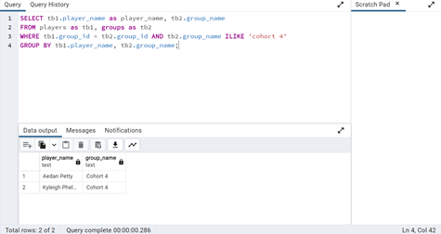
Q1. List all students, who play for a particular department (i.e. Cohort 4group).
Joins ‘players’ and ‘groups’ tables using ‘group_id’ as a key.
Filters for rows where group name is ‘Cohort 4’
Test: Successful

Slide 10
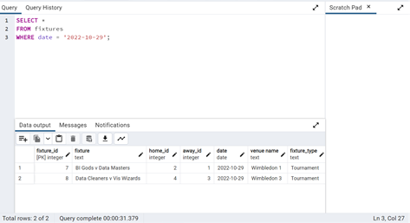
Q2. List all fixtures for a specific date (i.e. 29th of October 2022).
All columns from ‘fixtures’ table are listed, filtering for rows where date is ‘2022-10-29’.
Test: Successful

Slide 11
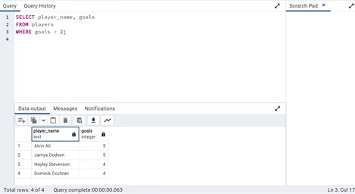
Q3. List all the players who have scored more than 2 goals.
Selects ‘player name’ and ‘goals’ columns, filtering for rows where there are more than 2 goals.
Test: Successful

Slide 12
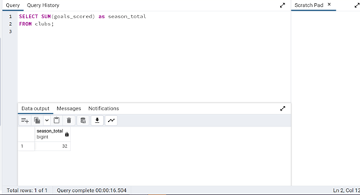
Q4. Return the total number of goals scored in the season
Query displays the sum of goals scored by all clubs involved in the tournament.
Test: Successful

Slide 13
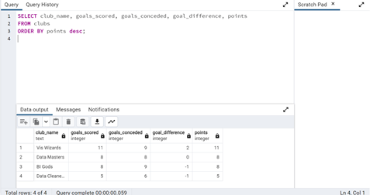
Q5. Return the number of goals in favour, goals against, goals difference and points by team
Requested columns are listed from ‘clubs’ table, ordered by most points.
Test: Successful

Slide 14
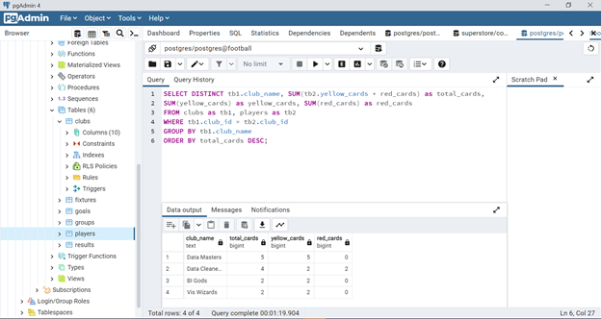
Q6. List the number of cards (yellow and red) per team
Joins clubs and players table using ‘club_id’ as a key.
Calculated total cards, yellow cards and red cards from ‘players’ table are listed with corresponding club names from ‘clubs’ table.
Rows are grouped by club name and ordered by the most total cards.
Ordered them based on most cards received to less cards received
Test : Successful

Slide 15
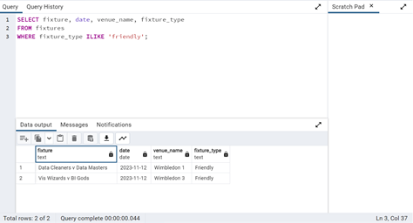
Q7. Return the games that are going to be played(friendly matches)
Select function fixture, date, venue_name, fixture type from ‘fixtures’
Where function chooses the friendly fixtures.
Test: Successful

Slide 16
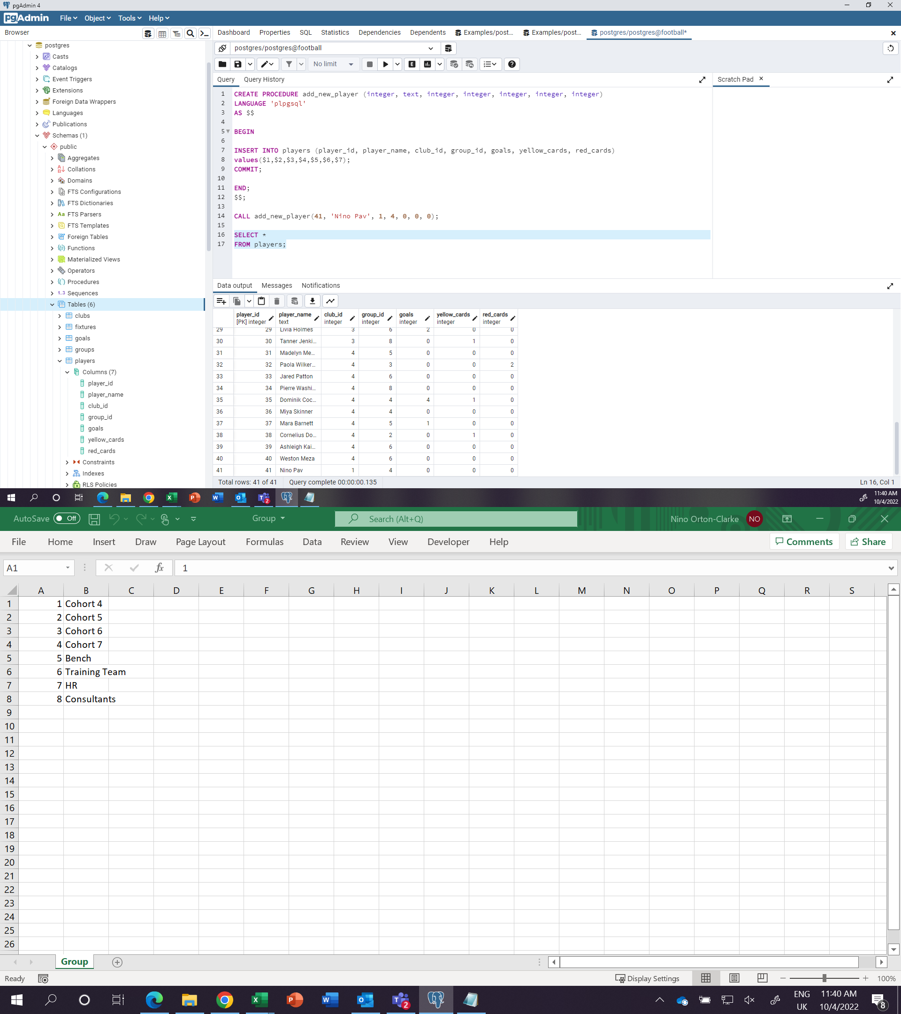
Q8. Develop a store procedure to add new players. It needs to consider warnings and exceptions.
Managed to implement the store procedure but without considering warnings and exceptions.
Test Unsuccessful

Slide 17
Task 4: Conclusion/Reflection
The majority of tests were successful, where the desired data was extracted in order to answer questions.
Unfortunately, Question 8 didn't take warnings and exceptions into consideration.
Data could also have been normalised further, using more tables i.e. a ‘cards’ table.

Slide 18

Thank you for listening

